Slide 1
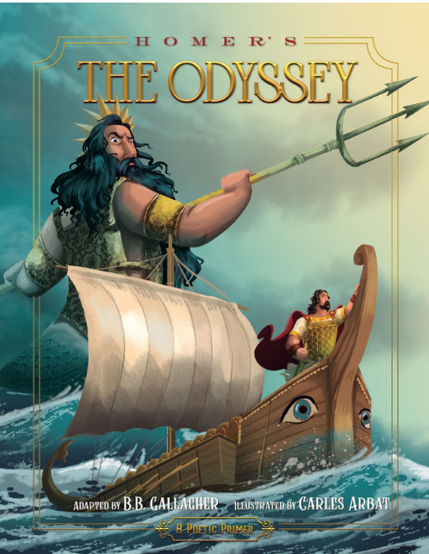
The Intellectual Property Odyssey of Cabotegravir
By,
Thomas Houze, Ph.D.
Notes:
My presentation is titled “The Intellectual Property Odyssey of Cabotegravir” and will tell the tale of the 15-year journey of Cabotegravir from a patent application to the bedside and clinic.

Slide 2
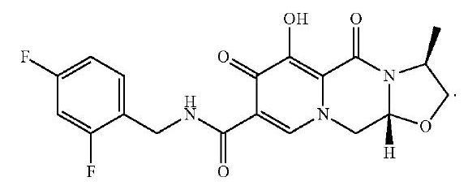
The following chemical structure represents Cabotegravir
Notes:
But unlike Ulysses who is the protagonist of the great Homeric novel The Odyssey, our Odyssey starts with a simple compound formulation called Cabotegravir and its journey from the lab to the clinic and my presentation will try to show how intellectual property management can drive innovation and help provide access to innovative new medicine like Cabotegravir (hereafter referred to as CABO) to where it is most needed.

Slide 3
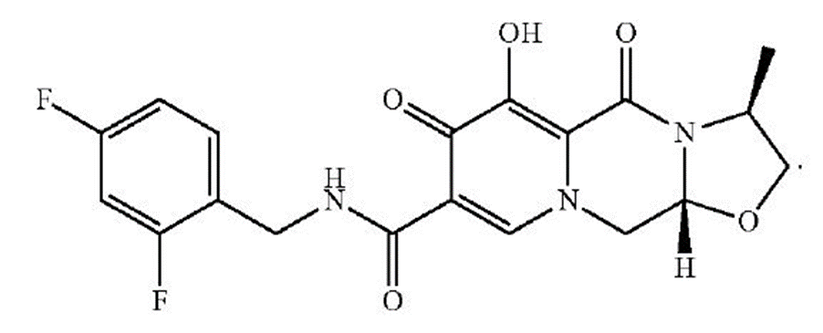
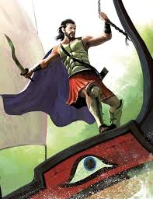
CABO is NOT Ulysses
and vice versa
Notes:
But throughout this presentation please remember not to confuse CABO with Ulysses they are in fact very different in many ways. ☺

Slide 4
But CABO and Ulysses also have much in common:
a long and storied journey to reach their final destination.
Notes:
But CABO and Ulysses have much in common: a long and storied journey to reach their final destination.

Slide 5
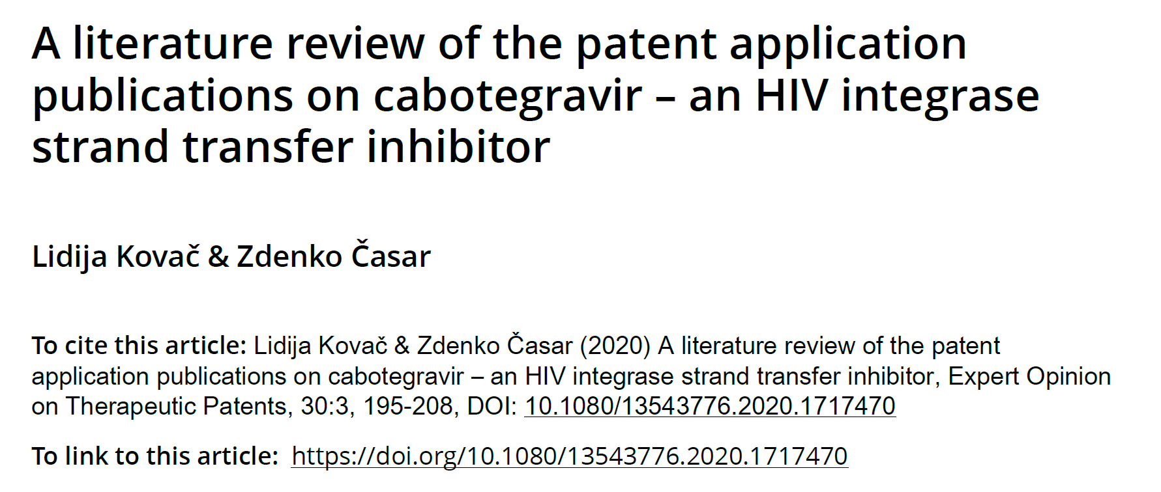
Notes:
To assist me in deciphering this journey I had the great fortune of having the guidance provided by the authors of this review article which chronicles the amount IP and IP tools needed to commercialize Cabotegravir.

Slide 6
Short tutorial on Property Rights and how they relate to Intellectual Property and Assets

Slide 7
What Rights are related to Intellectual Property?
Rights are legal, social, or ethical principles of freedom or entitlement; that is, rights are the fundamental normative rules about what is allowed of people or owed to people according to some legal system, social convention, or ethical theory.[1]
In Civil law, real right refers to a right that is attached to a thing rather than a person. Real rights include ownership, use, pledge…etc
Personal rights are the rights that a person has over their own body.
Moral rights are rights of creators of copyrighted works generally recognized in civil law jurisdictions and, to a lesser extent, in some common law jurisdictions.[2]
1. "Stanford Encyclopedia of Philosophy". Stanford University. July 9, 2007. Retrieved 2009-12-21.
2. Sundara Rajan, Mira T. (2006). Copyright and Creative Freedom: A Study of Post-Socialist Law Reform. Routledge Studies in International Law. Taylor & Francis. pp. 41–42. ISBN 978-0-20396-776-8.

Slide 8
Moral rights
Moral rights are personal rights that connect the creator of a work to their work. Moral rights are about being properly named or credited when your work is used, and the way your work is treated and shown. Moral rights require that your name is always shown with your work. This is called right of attribution.

Slide 9
Moral rights (con’t)
Anything else that may detract from the artist's relationship with the work even after it leaves the artist's possession or ownership may bring these moral rights into play. Moral rights are distinct from any economic rights tied to copyrights. Even if an artist has assigned his or her copyright rights to a work to a third party, he or she still maintains the moral rights to the work.[1]
1. Sundara Rajan, Mira T. (2006). Copyright and Creative Freedom: A Study of Post-Socialist Law Reform. Routledge Studies in International Law. Taylor & Francis. pp. 41–42. ISBN 978-0-20396-776-8.

Slide 10
A patent is a government-granted monopoly to build, sell, and use your invention (and prevent others from doing so). If you are issued a patent, it’s usually good for 20 years. After 20 years, your patent expires and anyone can copy, build, and sell your invention.
In exchange for the “monopoly,” one must disclose the details of ones invention to the public so that someone “practiced in the arts” could recreate it.
To receive a patent your idea must meet four requirements:
The subject matter must be “patentable” (as defined by Congress and the courts).
Your idea must be “new.”
The idea must be “useful.”
Your idea must be “non-obvious.”
*Patents are a government granted monopoly and therefore not a Moral Right and can be lost or taken away.

Slide 11
Doctrine of Fair Use in Some of Patent Law
Historically, the Supreme Court has compared patent and copyright laws[1]
These comparisons frequently result in the application of some patent doctrines to copyright law[2]
For example, the Supreme Court derived copyright’s secondary liability standard from patent law[3]
Following the Court’s example, several circuit courts have read patent standards into copyright law[4]
The doctrinal overlap, evidenced by the cross application of these standards, is not surprising given the close relationship between the copyright and patent regimes[5]
1. See, e.g., Eldred v. Ashcroft, 537 U.S. 186, 188 (2003) (noting in a copyright case that “the Court’s inquiry is significantly informed by the fact that early Congresses extended the duration
of numerous individual patents as well as copyrights” and that “the Court has found no constitutional barrier to the legislative expansion of existing patents”); Baker v. Selden, 101 U.S. 99, 102 (1879)
(comparing the “province” of patent and copyright).
2. See, e.g., Sony Corp. of Am. v. Universal City Studios, Inc., 464 U.S. 417, 440-42 (1984) (importing patent’s staple article doctrine into copyright); Metro-Goldwyn-Mayer Studios, Inc. v. Grokster, Ltd., 545 U.S. 913, 935 n.10 (2005) (noting that patent law’s staple article doctrine does not exempt from liability those who induce infringement).
3. See Sony, 464 U.S. at 440-42 (importing the “staple article” doctrine as safe harbor to secondary liability for copyright infringement); see also Grokster, 545 U.S. at 936 (holding that patent’s inducement rule is “a sensible one for copyright.”).
4. The best example of this is the standard for copyright misuse, which was first imported into copyright by the Fourth Circuit. See Lasercomb America, Inc. v. Reynolds, 911 F.2d 970, 973 (4th Cir. 1990). Other circuits followed the Fourth Circuit’s example in adopting a copyright misuse standard. See A&M Records, Inc. v. Napster, Inc., 239 F.3d 1004, 1026-27 (9th Cir. 2001); DSC Communications Corp. v. DGI Techs., Inc., 81 F.3d 597, 601 (5th Cir. 1996).
5. See Dotal Oliar, The (Constitutional) Convention on IP: A New Reading, 57 UCLA L. Rev. 421, 463-69 (2009) (suggesting that the IP Clause should not be read disjunctively). Cf. Karl B. Lutz, Patents and Science: A Clarification of the Patent Clause of the U.S. Constitution, 18 Geo. Wash. L. Rev. 50, 51 (1949) (presenting the IP Clause as providing two independent powers).

Slide 12
Doctrine of Fair Use in Some of Patent Law (con’t)
The scope of a patent is established during the Patent and Trademark Office’s examination of a patent application[1]
Once granted, the patent’s scope is defined by its claims[2]
The scope of a copyright, on the other hand, is largely established after creation, frequently through fair use*[3]
*The fair use of a patent would allow the law to adapt to changing circumstances after the issuance of the patent, just as it does in copyright.
1. See id. at 1186 (describing PTO examination as establishing the “metes and bounds of the inventor’s property right”).
2. 35 U.S.C. § 112 (“The specification shall conclude with one or more claims particularly pointing out and distinctly claiming
the subject matter which the applicant regards as his invention.”). Patent claims set out the “metes and bounds” of what the inventor claims as his invention. See O’Rourke, supra note 9, at 1186.
3. See O’Rourke, supra note 9, at 1184 (noting that copyright has “few requirements for initial protection,” but that it still has several scope-limiting doctrines).

Slide 13
The two most important take home lesson from all of the above slides are:
That there are rights that cannot be taken away which are called moral rights and there are rights that can be taken away of sold which are real rights.
The Patent Office is just an administrative entity which establishes and grants a patent based on the scope of the claims of the patent but in the end the Courts determine the true scope of the patent or even whether the patent is valid.

Slide 14
The first synthesis of the Cabotegravir molecule
Applicant Shionogi & Co., Ltd. filled the patent application WO 2006/116764 A1 [1] for cabotegravir in April 2006.

Slide 15
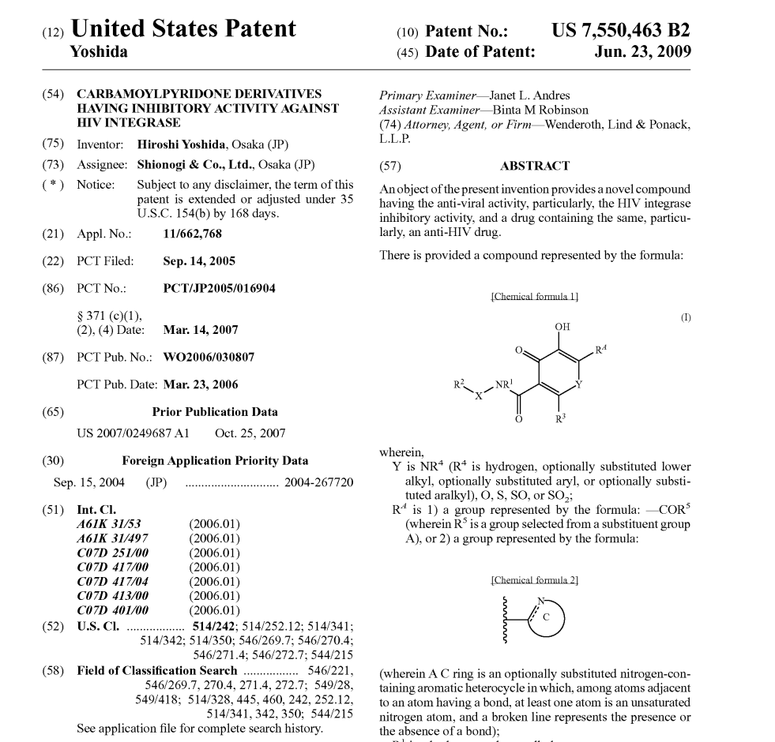

Slide 16
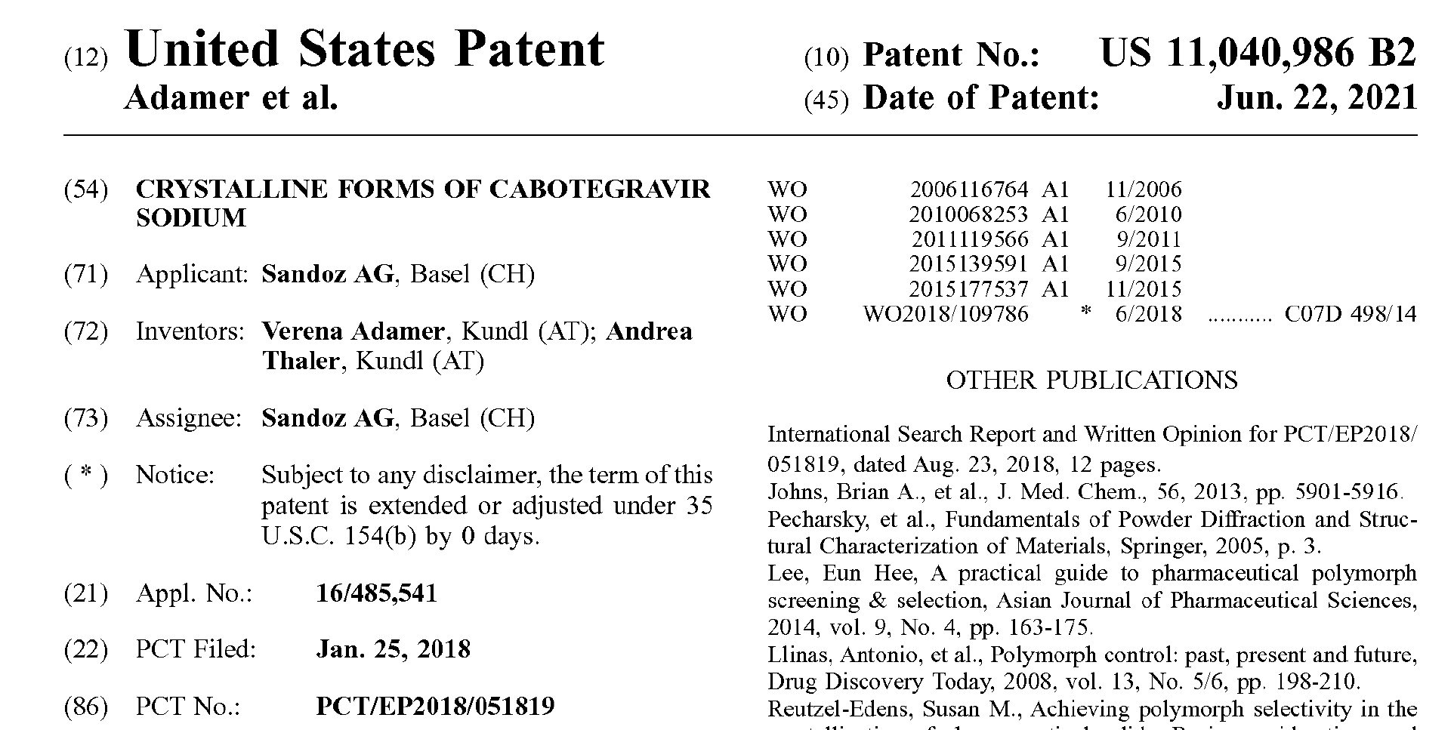
Notes:
My curiosity in the IP history of Cabotegravir started when I was asked by my Branch Chef James Cummins to see if and for how long will Cabotegravir be on patent. Consequently, I did a quick patent search which produced the document seen in this slide which is a US Patent issued to the Swiss Company Sandoz in June 2021.

Slide 17
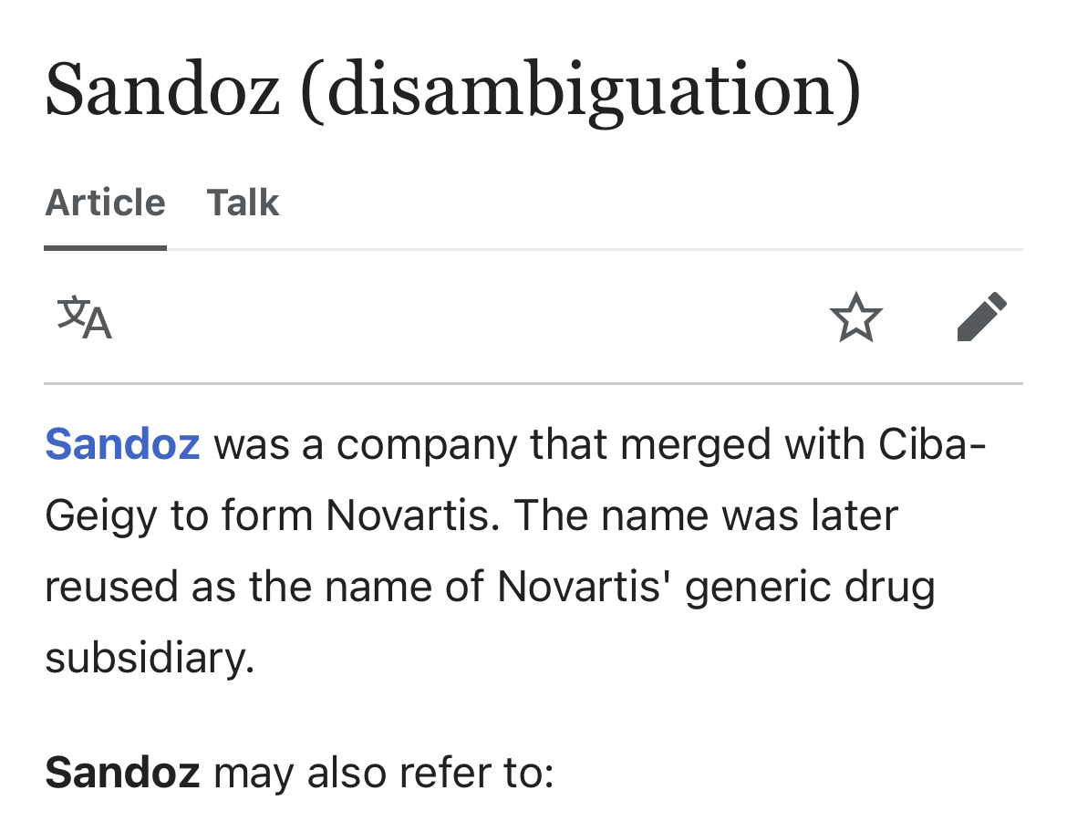
Notes:
What tweaked my curiosity was that I had always been told a company named ViiV Healthcare held the rights to Cabotegravir and I was aware that Sandoz as an independent company no longer existed so I started following the bread crumps to see where they might lead me, and the path leading to my first destination on my Odyssey which was the Land of Trademarks. It seems that the trademark name Sandoz was acquired by Novartis during a merger and is now the name of Novartis’ generic drug subsidiary.

Slide 18
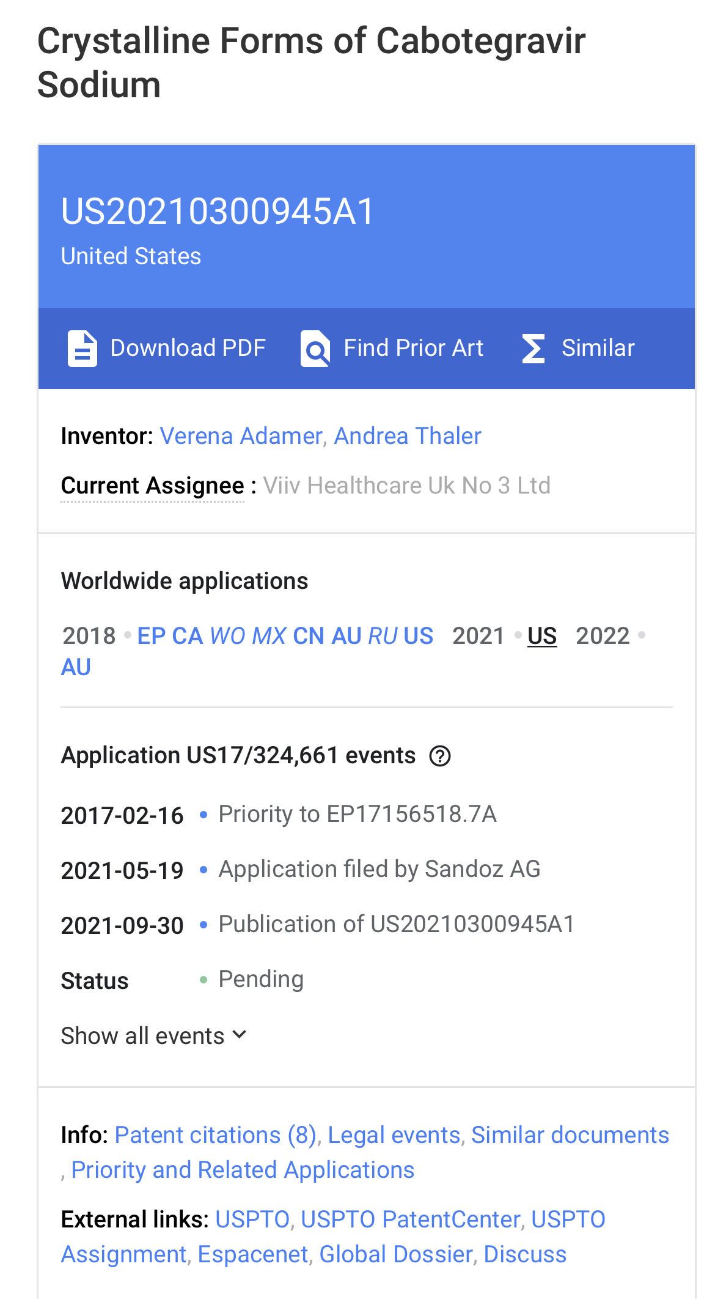

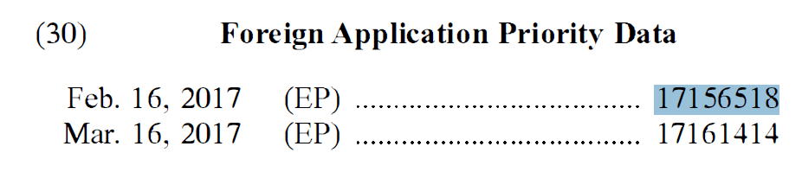
Priority date refers to the earliest filing date in a family of patent applications.
In 37 CFR 3.1, assignment of patent rights is defined as "a transfer by a party of all or part of its right, title and interest in a patent [or] patent application...."
Notes:
When I research a little deeper, both of the application in Panel 5 above and here in Panel 7 have the same “Foreign Priority” EP document so they are related. This time I utilized a different database I discovered that CABO has a Priority filing date of February 2017 by virtual of a European patent application and more importantly that the current assignee is ViiV Healthcare which is more aligned with what I have been told but then this begged the question how did a patent filed by Sandoz (which no longer exist as an independent company) end up be assigned to ViiV Healthcare and the answer is the ViiV healthcare was assigned the original composition of matter patent from 2006.

Slide 19
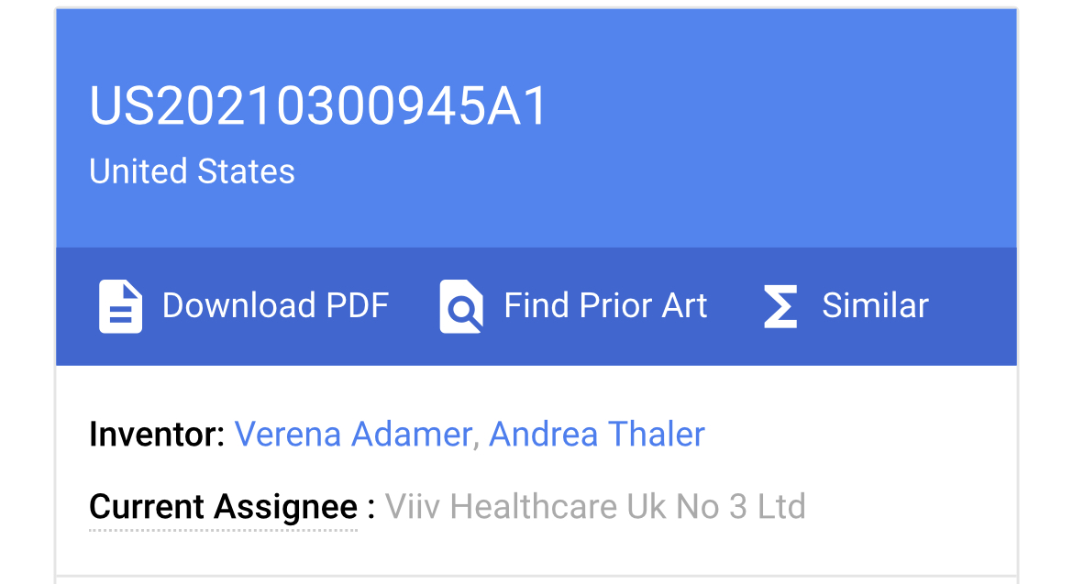
Notes:
We can clearly see that this patent has been assigned to ViiV Healthcare and having a priority date of February 2017 we know that the patent has 15 years left on its 20-year term for the new synthesis method from Sardoz.

Slide 20
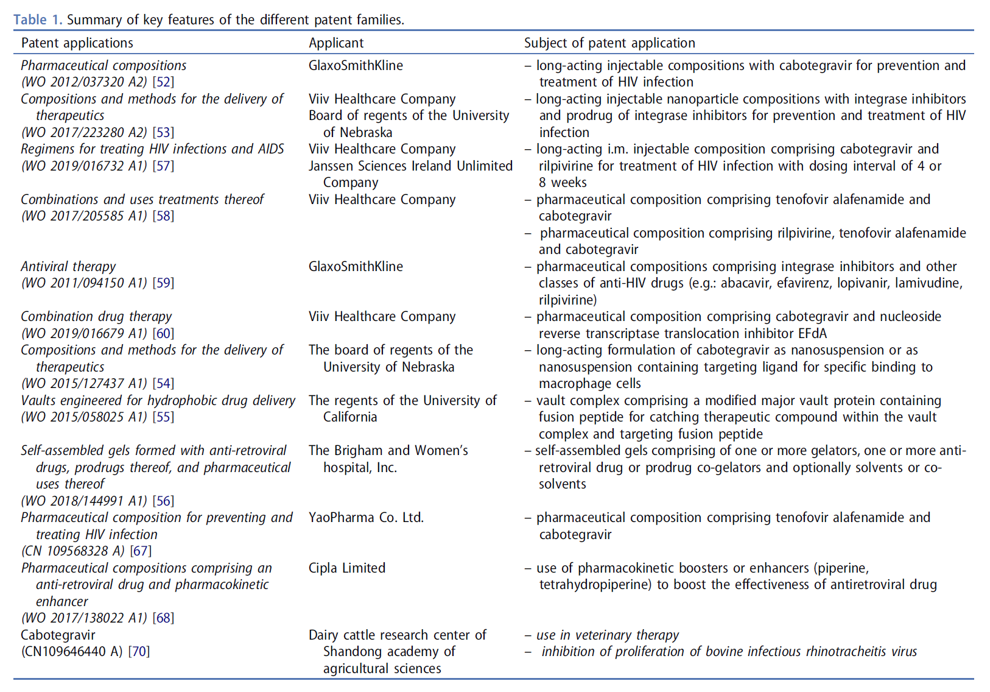
Notes:
This table is taken from the journal that I mentioned earlier and shows the principal patents (there are many more) that make up the patent families for CABO. Since GSK and ViiV Healthcare own the original composition, any other company wanting to manufacture, sell, or (commercially) use CABO must get a license from ViiV Healthcare since it is a Primary Rights Holder and as we will see later in the process ViiV Healthcare has placed its patents in the Medicines’ Patent Pool.

Slide 21
Patent review
1.1. Primary rights holders
ViiV Healthcare was established (2009) by GlaxoSmithKline and Pfizer dedicated to delivering advances in treatment and care for people living with HIV and for people who are at risk of becoming infected with HIV. Shionogi joined as a shareholder in October 2012.
Notes:
Shionogi Limited was the first company to synthesize and characterize CABO as an anti-retroviral drug against HIV back in 2006 and they still have 5 years left on their 20-year patent term as of 2022.

Slide 22
Primary rights holders (continued)
1.2. Cabotegravir molecule
Applicant Shionogi & Co., Ltd. filled the patent application WO 2006/116764 A1 [1] for cabotegravir in April 2006.
Included the process of preparation of the cabotegravir
Description and results of measurement of inhibition rate (IC50 value) was also presented.
Formulations alone or in combination with other antiviral agents such as reverse transcriptase and protease inhibitors for the treatment or prophylaxis of an HIV infection.
1. Taishi T, et al., inventor; Shionogi & Co., Ltd., assignee. WO 2006/116764 A1. 2006.
Notes:
Therefore, no matter what new method is invented to make the composition (drug) the final product still belongs to Shionogi Ltd. as long the final product is the same or the functional equivalent (Doctrine of Equivalents) of the compound which was synthesized in 2006.

Slide 23
1.2 Secondary rights holders
1.2.1. Cabotegravir drug substance synthesis and solid-state forms
Different other companies (e.g.: Cipla Limited, Lek Pharmaceuticals d.d., Lupin Limited) filled patent applications for improved synthetic processes to cabotegravir [2–4]. In year 2018 Sandoz AG and Cipla Limited filled two separate
patent applications describing different polymorphs and salts of cabotegravir [5,6].
2. Sawant AA, et al., inventor; Cipla Limited, assignee. WO 2015/177537 A1. 2015.
3. Čusak A., et al., inventor; Lek Pharmaceuticals d.d., assignee. WO 2016/113372 A1. 2016.
4. Jadhav HS, et al., inventor; Lupin Limited, assignee. WO 2017/109649 A1. 2017.
5. Thaler A., et al., inventor; Sandoz AG, assignee. WO 2018/149608 A1. 2018.
6. Tarate SN, et al., inventor; Cipla Limited, assignee. WO 2018/109786 A1. 2018.
Notes:
Secondary rights holders even if they have patents for improved synthesis methods for CABO still must get a license from the current Primary Rights Holder if they want to commercially sell or use CABO.

Slide 24
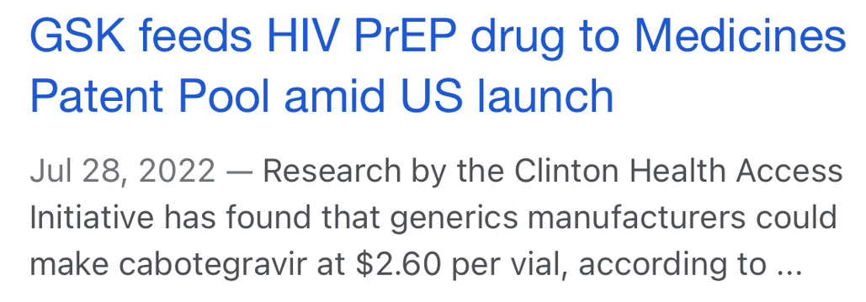
Notes:
GSK after establish patent exclusivity through ViiV Healthcare next step is to add its patents for CABO to the Medicines Patent Pool

Slide 25

"Licenses also provide the freedom to develop new treatments better suited for resource-limited settings, such as pediatric formulations and fixed-dose combinations.“
And with the addition of GSK and ViiV Healthcare, the names of some of the commercial partners in these agreements the “MPP also worked with Janssen [7] and Boehringer Ingelheim [8] to extend their non-assert policies... ’to ensure’ that the companies will not assert their patent rights in many more developing countries."
7. "The Medicines Patent Pool on Janssen's Extension of its Access Policy for Pediatric Medicine Darunavir." Medicines Patent Pool. Retrieved 9 October 2017.
8. "Boehringer Ingelheim increases access to the medication for the treatment of HIV/Aids." Boehringer Ingelheim. Retrieved 9 October 2017.
Notes:
The medicines Patent Pool is a United Nations-backed public health organization working to increase access to, and facilitate the development of, life-saving medicines for low- and middle-income countries. The use of patent pools is an efficient means to establish an agreement between two or more patent owners to license one or more of their patents to one another or to third parties. Often, patent pools are associated with complex technologies that require complementary patents in order to provide efficient technical solutions and therefore this tool is well suited for medical therapeutics.

Slide 26
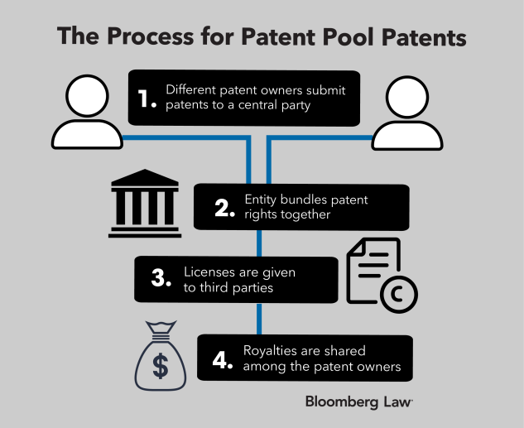
Pooling Patents
Taken from: Bloomberg Law – Pooling Patents to Speed Virus Treatments More Logical Than Easy
https://news.bloomberglaw.com/ip-law/pooling-patents-to-speed-virus-treatments-more-logical-than-easy
Notes:
This tools avoids patent litigation and speeds up the innovation translation process and saves time, energy, and money yet still provides royalty income which is shared among the patent owners.

Slide 27
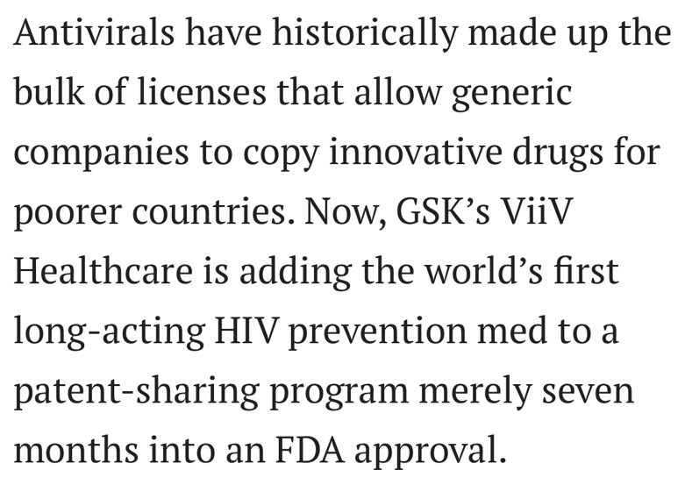
Notes:
The speed at which GSK and ViiV Healthcare were able to introduce Cabotegravir to the Medicines’ Patent Pool only seven months after FDA approval is admirable and remarkable.
I certainly do hope that more pharmaceutical companies use this tool in the future to speed up the translation of innovation to the clinic, especially in places where they are most needed.

Slide 28
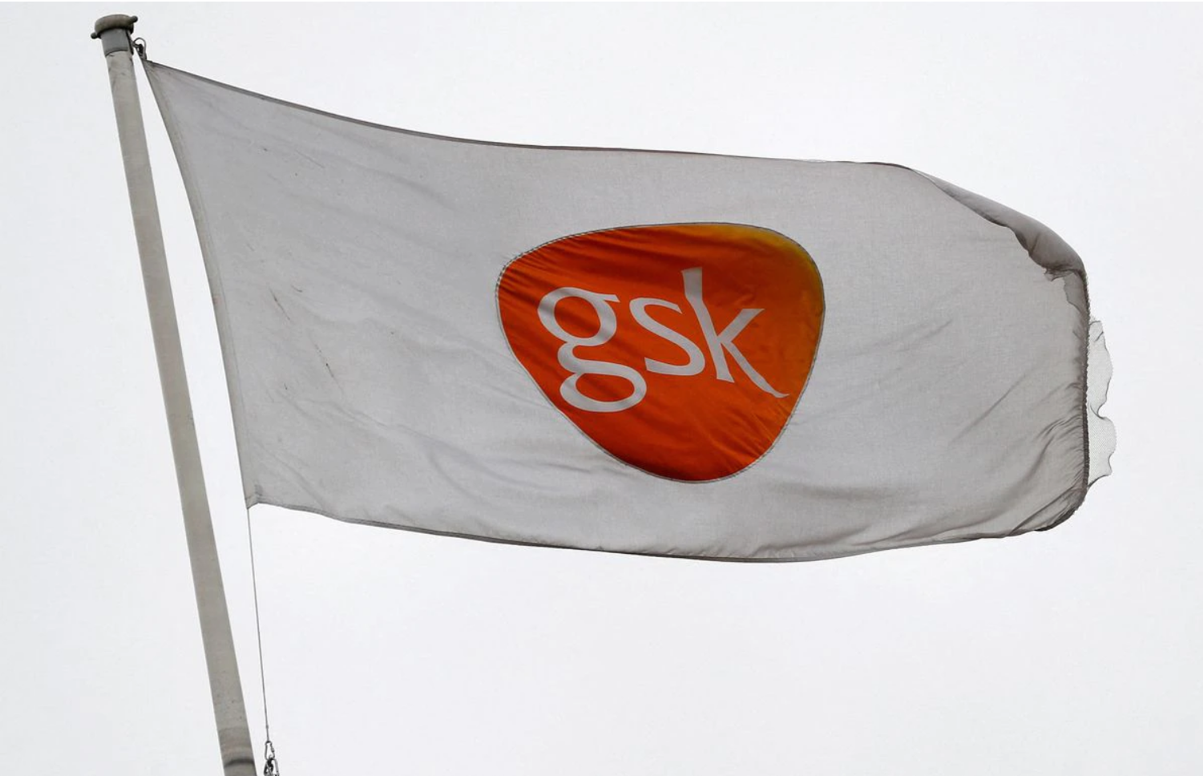
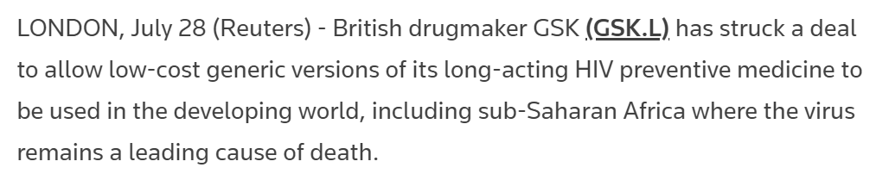
Notes:
ViiV Healthcare and its parent company GSK have moved at record speed to enable the use and eventual manufacture of CABO in low to moderate income countries and will certainly save countless lives and prevent unnecessary suffering in sub-Saharan Africa.

Slide 29
Questions
Notes:
Any questions please?

Slide 30
THE END
Notes:
The End, thank you for your time patience and indulgence.

